Slide 1
Chapter 10
How do Computers Share Information so that I can Exchange Materials with Others Using a Computer Network?

Slide 2
Initially
Connected to central server
Printers
File storage and sharing
Used terminals to connect
Could use any connected machine
All became equivalent
Files became independent of specific computer
Use logical location, not physical

Slide 3
File Transfer Protocol
An early way (1971) to share files widely
Centralized
Authenticated or anonymous
Log in, get/put files, log out
Client/server
Username, password, and files transmitted in the clear
SFTP adds encryption

Slide 4
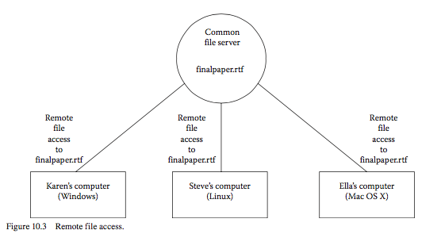
Remote File Access

Slide 5
Remote File Access
File appears to be on the local computer
Any number of computers can read
If one writes, coherence lost
Now readers don’t have up-to-date information
If more than one writes, chaos
Which writes take precedence?
What if two people change same information?

Slide 6
Shared Files
Write-through: update when change made
Continuous traffic
Write-on-close: don’t write until application closes
Delayed write: batch changes accumulated in a certain amount of time

Slide 7
Coherence
Client-initiated update
Client requests updates when user asks or app decides
Server-initiated
Server keeps track of clients and pushes new information
Still have concurrent update problem

Slide 8
Concurrent Updates
Humans can coordinate
Edit only certain parts of file
Server can create locks
On the whole file so that only one person can edit
On part of a file (equivalently DB)
Users can specify if they are only reading
Or what they want to modify

Slide 9
Concurrent Updates
These days, web applications allow multiple people to modify at the same time
All users see other users’ modifications
Strong revision control

Slide 10
Windows
Domains and workgroups
Domains control users, passwords, file access
Workgroups can be formed of specific users in a domain
Folders and files can be specified as shared
Network discovery finds shared resources
SMB, CIFS, etc.

Slide 11
OS X
Similar
Bonjour
Can work with Windows sharing

Slide 12
NASty
Network Attached Storage
Machine that only serves files
Typically doesn’t have user logins, only administrative logins
Single purpose
Faster
More reliable
Works with many different file sharing protocols

Slide 13
Any Port in a Packet Storm
Servers need to differentiate between different types of requests
SMB, Bonjour/Appletalk, FTP, NFS, etc.
Servers have a constant (IP) address
Different services reached via different port numbers
Think telephone extension number
0 -- 65535

Slide 14
Ports
20, 21: FTP
22: SSH
23: Telnet
25: SMTP
80: HTTP
443: HTTPS
https://www.ietf.org/rfc/rfc1700.txt

Slide 15
Ports
A server can serve a number of different services (protocols)
Client connects to a well-known port
Client has port too, typically high-numbered (>1023)
Server has to know client port for two-way communication

Slide 16
Port Assignment
Internet Corporation for Assigned Names and Numbers (ICANN)

Slide 17
Layers
A way to simplify and generalize the complexities of network software
Open Standards Interconnection model

Slide 18
Layer 1: Physical
Cabling
Signaling

Slide 19
Layer 2: Data Link
Frames
Communication between connected machines
LAN
Start and end symbols
Error detection

Slide 20
Layer 3: Network
Move data between LANs
Routing
Internet Protocol
Packets
Each routed independently
Aids in resiliency
Multiple routes

Slide 21
Layer 4: Transport
Messages into packets
Two general types
Connection-oriented
Connectionless

Slide 22
Connection Oriented
Packets are checked for arrival
If no acknowledgement, retry
If no acknowledgement in a certain amount of time, notify application of failure
Metaphor: telephone
Transmission Control Protocol (TCP)
Most familiar protocols

Slide 23
Connectionless
Message sent, but not checked for receipt
Useful for non-essential or real-time messages
Less overhead
User Datagram Protocol (UDP)
Domain Name System
Simple Network Management Protocol
Streaming audio and video

Slide 24
Layers 5, 6, 7
Session
Check-pointing, rollback, etc.
Presentation
How the data look
ASCII, compression, etc.
Application
How the user interacts
5 and 6 not present in TCP/IP, merged into 7

Slide 25
Updates from the Web
A lot of data are dynamic
News, weather, etc.
Pull versus push
Pull
Really Simple Syndication (RSS)
Atom
eXtensible Markup Language (XML)

Slide 26

Updates from the Web

Slide 27
Updates from the Web
Use a reader or aggregator
Checks for you and presents new information

Slide 28
Cloud Computing
“A model for enabling ubiquitous, convenient, on-demand access to a shared pool of configurable computing resources”
An evolution of using other organization’s resources
E.g.: Amazon built out resources for Christmas but doesn’t need the capacity all the time
Elastic computing
Notes:
https://en.wikipedia.org/wiki/Cloud_computing

Slide 29
Cloud Computing
Europe is busy when the US is asleep
Pay as you go
No need to buy and depreciate hardware locally
Hardware virtualized
Many operating system instances running on one machine
Enough capacity to have remote machine behave as if local (everywhere)

Slide 30
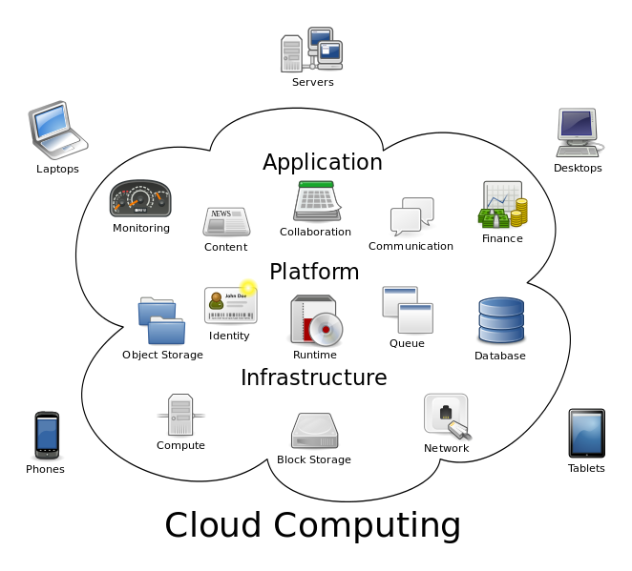
Diagram

Slide 31
Cloud Computing
Providers
Amazon
Google
Microsoft Azure
Rackspace
Dropbox

Slide 32
NIST
On-demand self-service
Broad network access
Resource pooling
Rapid elasticity
Measured service

Slide 33
Types of Services
Infrastructure as a service (IaaS)
Visible hardware resources
Platform as a service (PaaS)
OS, programming language, DB, added to service
Automatic scaling (elasticity)
Software as a service (SaaS)
Users only see application
WordPress etc.

Slide 34
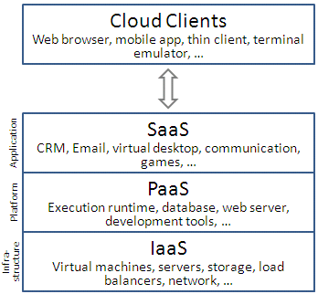
Layers

Slide 35
Visibility
Private
All resources only visible within organization
Hosted inside or out
If out, VPN used to connect
Public
All resources visible everywhere
Hybrid
Some private, some public

Slide 36
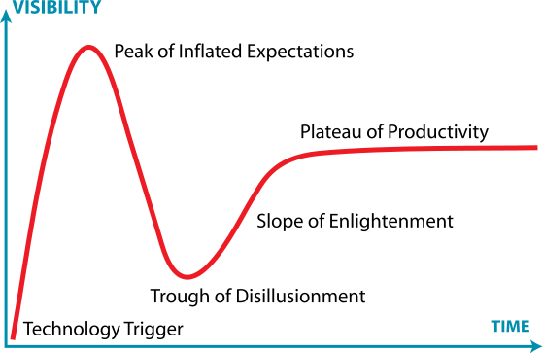
Gartner Hype Cycle

Slide 37
Peer to Peer (P2P)
Decentralized computing, networking, storage
Each client is also a server
“Computing or networking is a distributed application architecture that partitions tasks or work loads between peers”
Peers allow a certain amount of their resources available to others
And vice versa
Notes:
https://en.wikipedia.org/wiki/Peer-to-peer

Slide 38
P2P
Original vision of web was more P2P
Everyone contributed
Napster early example
Centralized DB of songs
Refers requesters to other nodes that contain songs
Songs weren’t supposed to be stored centrally

Slide 39
P2P
Pure P2P
Nothing centralized
All information distributed
Gnutella, Kazaa
Structured
Certain machines keep track of information (trackers)
BitTorrent

Slide 40
P2P
Very resilient to node loss
Used to distribute Linux distributions
And of course a lot of copyrighted data
Part of the network neutrality issue

Slide 41
Review
Questions: 2, 3, 8
Exercises: 2, 3, 4, 5, 10

